Slide 1
Baranov Mykola
SOA/Microservices/3tier/Embed

Slide 2
Service-oriented architecture

Slide 3
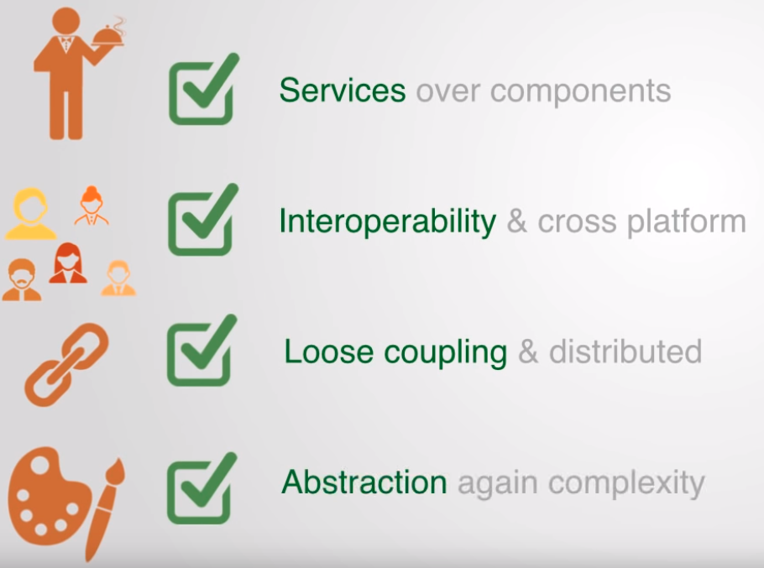
Service-oriented architecture
Service-oriented architecture (SOA) is a style of software design where services are provided to the other components by application components, through a communication protocol over a network. The basic principles of service-oriented architecture are independent of vendors, products and technologies.

Slide 4
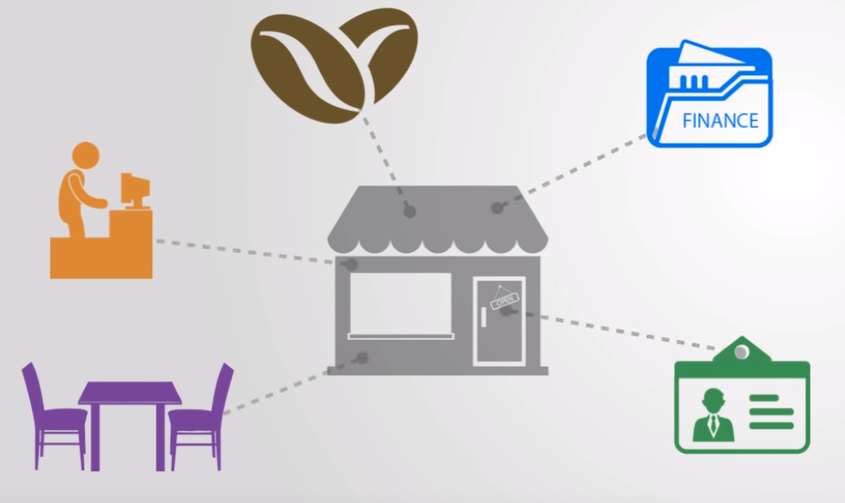
Service-oriented architecture

Slide 5
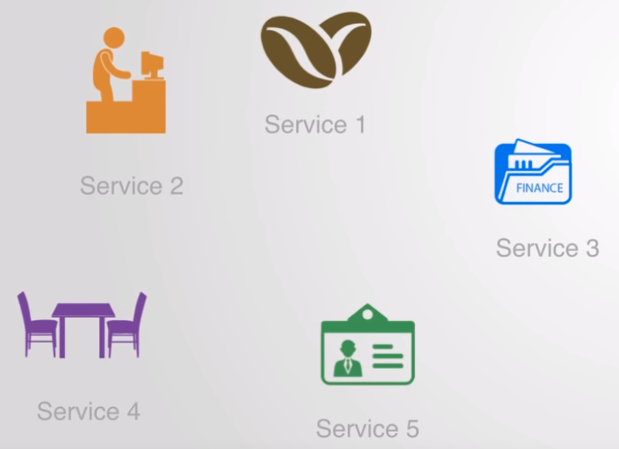
Service-oriented architecture

Slide 6
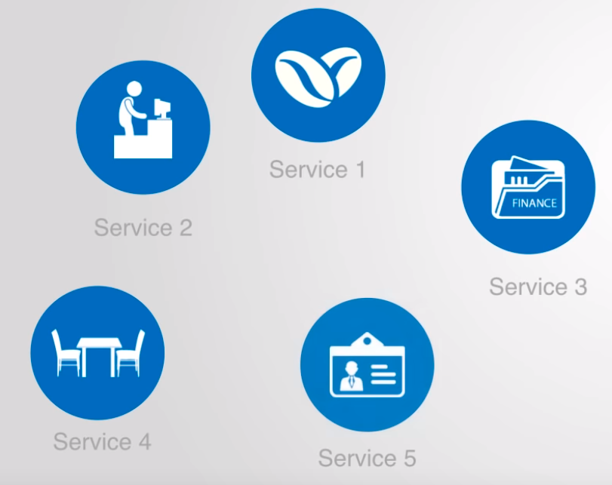
Service-oriented architecture

Slide 7
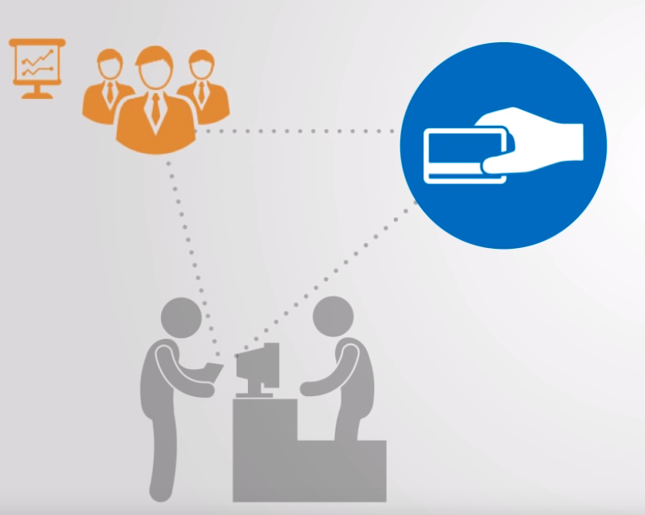
Service-oriented architecture

Slide 8

Service-oriented architecture

Slide 9
Microservices

Slide 10
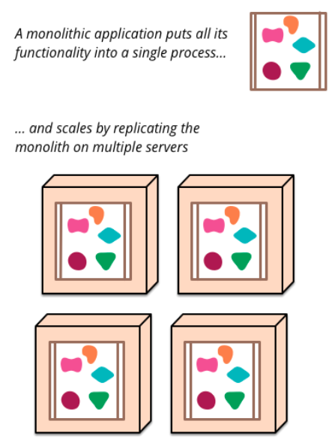
Microservices
Monolithic

Slide 11
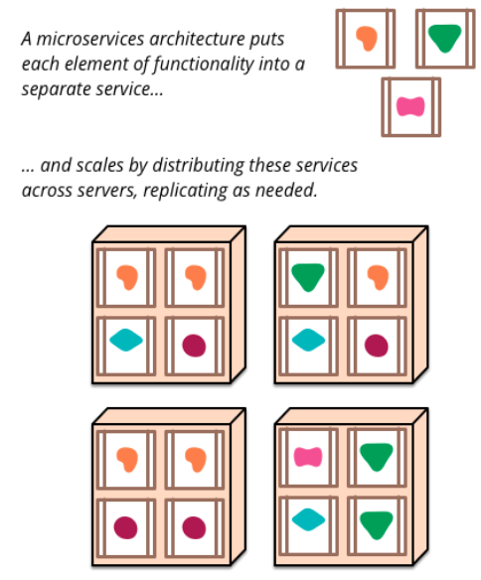
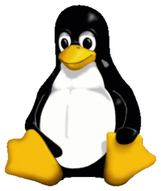
Microservices
Microservices

Slide 12
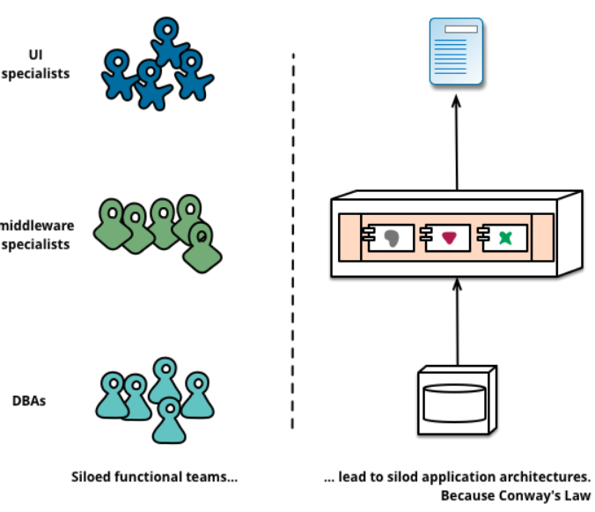
Microservices
Teams
Cooperations

Slide 13
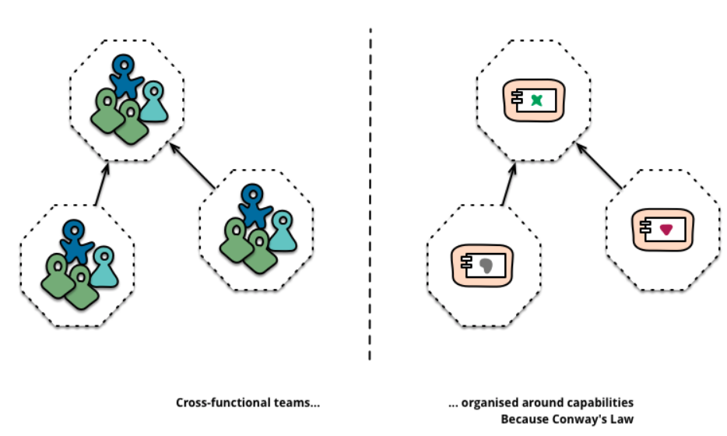
Microservices
2 Pizza Team

Slide 14
3 Tiers

Slide 15
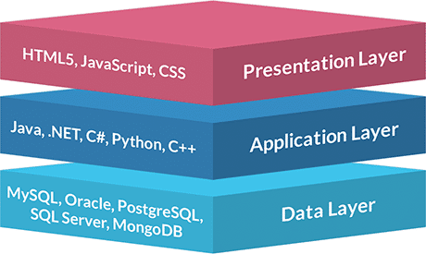
3 Tiers
3 Layers

Slide 16
3 Tiers
Scalability — Each tier can scale horizontally. For example, you can load-balance the Presentation tier among three servers to satisfy more Web requests without adding servers to the Application and Data tiers.
Performance — Because the Presentation tier can cache requests, network utilization is minimized, and the load is reduced on the Application and Data tiers. If needed, you can load-balance any tier.
Availability — If the Application tier server is down and caching is sufficient, the Presentation tier can process Web requests using the cache.

Slide 17
3 Tiers
Scalability — Each tier can scale horizontally. For example, you can load-balance the Presentation tier among three servers to satisfy more Web requests without adding servers to the Application and Data tiers.
Performance — Because the Presentation tier can cache requests, network utilization is minimized, and the load is reduced on the Application and Data tiers. If needed, you can load-balance any tier.
Availability — If the Application tier server is down and caching is sufficient, the Presentation tier can process Web requests using the cache.

Slide 18
Embedded

Slide 19
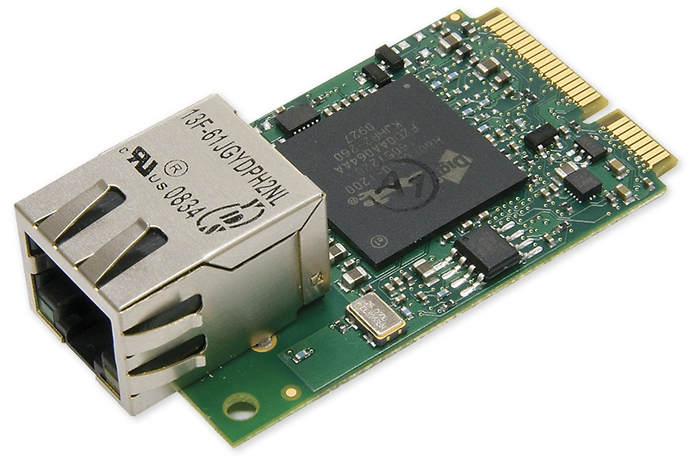
Embedded
Limited Resources (Low ROM, RAM & CPU Performance)
High Reliability

Slide 20
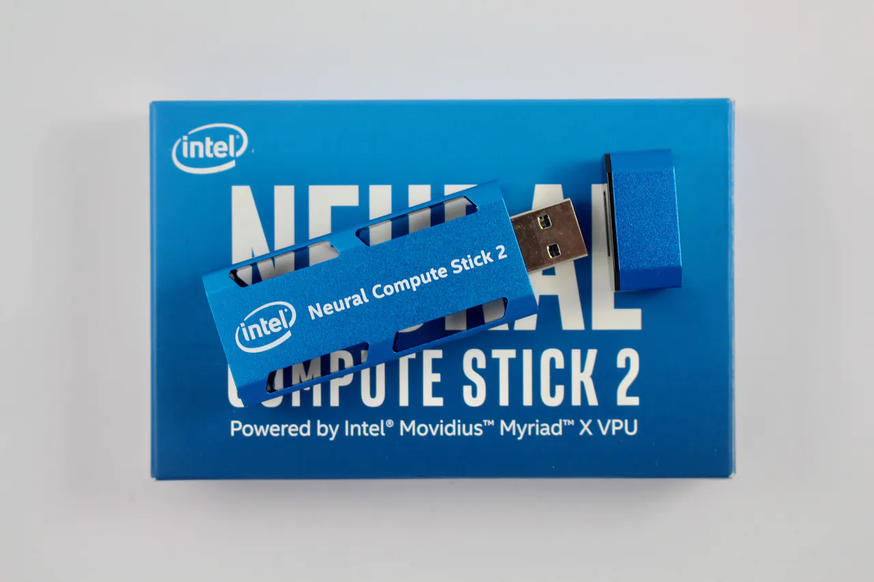
Neural Compute Stick

Slide 21
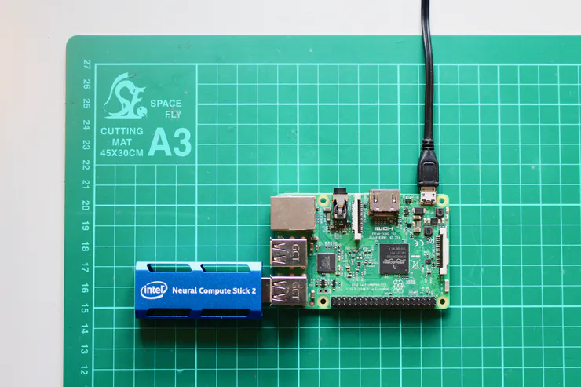
Neural Compute Stick with Raspberry PI

Slide 22
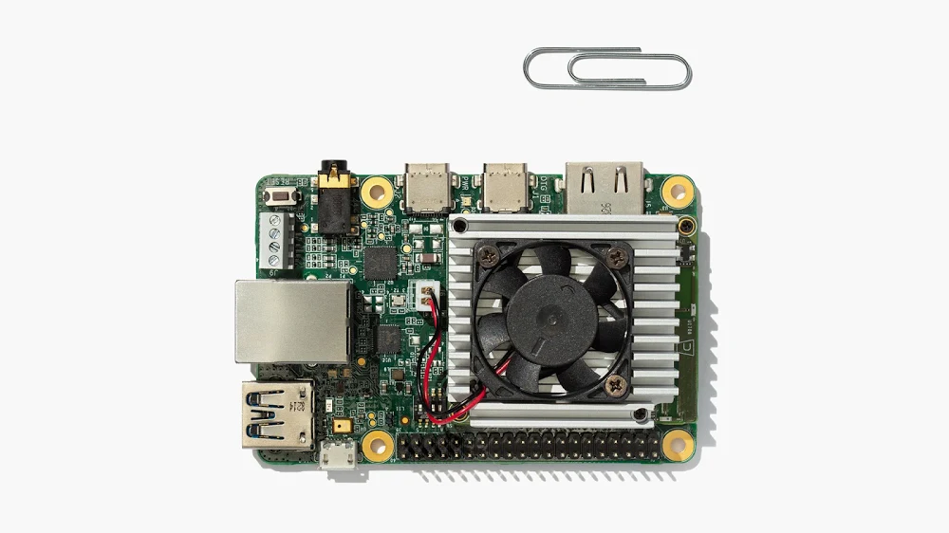
Google Coral Dev Board

